Slide 1


Health Services
United States Marine Corps
HMCM(FMF/SCW/SW) Robert A. White
10 MAY 2013
UNCLASSIFIED

Slide 2


USMC Personnel
Total Deployed: ~21,100
Total Afghanistan: ~8,700
Active Component - Operating Forces: 118,147
Trainees, Transients, Patients, Prisoners: 30,174
Supporting Establishment: 46,004
Activated Reservists: 2,269
Active Reserve: 2,248
Total on active duty: 198,842
Notes:
Photo:Marines assigned to the 26TH Marine Expeditionary Unit (MEU) stand armed watch on the flight deck of the amphibious assault ship USS Kearsarge (LHD 3) while transiting the Suez Canal on April 5, 2013. Kearsarge is the flagship for the Kearsarge Amphibious Ready Group and, with the embarked 26TH MEU, is deployed in support of maritime security operations and theater security cooperation efforts in the U.S. 5th Fleet area of responsibility. Photo by U.S. Navy Mass Communication Specialist 2nd Class Thomas Henderson.

Slide 3

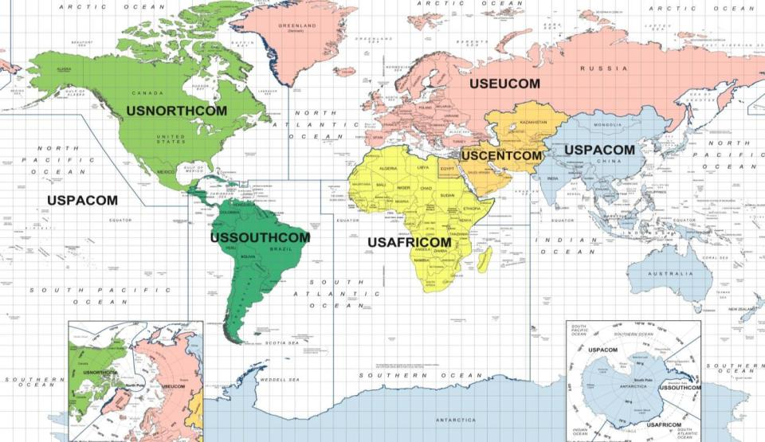
Global Force Disposition
(As of 9 May 13)
Operations
~11,300
+
Amphibious Ops
~5,800
+
Exercises
~4,300
+
TSC
~400
=
Total Deployed
~21,800
NORTHCOM: ~100
EUCOM: ~600
AFGHANISTAN: ~9,000
OTHER CENTCOM: ~3,800
UScentcom
OEF-AFGHANISTAN
jORDAN OPERATIONAL
DEPLOYMENT PROGRAM
YEMEN embassy reinforcement
Uae security cooperation
USNorthcom
UNIT LEVEL TRAINING 4-13
USEUCOM
GEORGIA DEPLOYMENT PROGRAM-isaf 2
BLACK SEA ROTATIONAL FORCE 13
15th MEU
uspacom
31ST MEU
USPACOM
Sps hsv-2 Swift
Ussouthcom
26th MEU
uscentcom
FAST PLTS
USEUCOM
USCENTCOM
USPACOM
USNORTHCOM
USSOUTHCOM
USSouthCOM
EX NEW HORIZOns
Small unit tactics ENGAGEMENT
Guatemala riverine trng
USAFRICOM
CJTF-HOA
Operation Onward LIBERTY
Libya Crisis Response OPS
Spmagtf-crisis response
Spmagtf-africa 13.2
EX Epic guardian 13
USPACOM
OEF-Philippines
Ex Guahan Shield 13
Ex Ssang yong
Mrf- darwin
ALAM HALFA
MARSOC
USCENTCOM
USPACOM
OPERATION
AMPHIBIOUS OPERATION
OTHER DEPLOYMENTS
SOUTHCOM: ~200
AFRICOM: ~500
PACOM: ~7600
3
Notes:
3
3
3

Slide 4

IDC MANNING
Inventory 292
Billets Authorized 282
8425 @ 89.1%
Total manning @ 103% (8425 & 8403)

Slide 5
2013 1st QTR IDC Compliance Report
1 MEF | 1ST QTR
1 MARDIV | 65.45%
1 MLG | 91.66%
3 MAW | 90.00%
1 MHG | 100.00%
1 MEF (total) | 80.43%
II MEF | 1ST QTR
II MARDIV | 96.00%
II MLG | 80.00%
II MAW | 100.00%
II MHG | 97.00%
CBIRF | 95.00%
MCSFR | 100.00%
II MEF (total) | 93.00%
III MEF | 1ST QTR
III MARDIV | 75.40%
III MLG | 95.45%
I MAW | 96.30%
III MHG | 83.33%
III MEF (total) | 87.86%

Slide 6

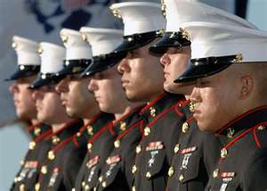

Garrison Med Home Port
Equivalent to 4 providers
(not bodies)
C-FTE
1.0 RN/team
1.0 LVN/team
1 nurse
1 LVN
Serving 4-5,000 Marines
2.5 HM
10 corpsman
1 clerk/team
1 clerk
Case Manager
Behavior Health

Slide 7

Point of Contacts
HMCM(FMF) Robert A. White Senior Enlisted Advisor
robert.a.white@usmc.mil
703-604-4558
HMCS(FMF) Eliza S. Rubic IDC Program Manager
eliza.rubic@usmc.mil
703-604-4557
HMCS(FMF) Christopher W. Pierson IG Inspector
  christopher.w.pierso@usmc.mil
  703-604-4598

